Slide 1

E-Commerce Sales Analysis in 2025
Presented by
Chun Hei, POON
27th March, 2026

Slide 2

AGENDA
Introduction
Methodology
Data Analysis
Final tips & takeaways
Business Strategy Advisory

Slide 3

THE POWER OF DATA SCIENCE

Slide 4

INTRODUCTION
E-Commerce generated $1.5 Billion Revenue in 2025
Biggest Business Segment in the Company
Books are highest earning with $129 Million in Revenue
Data Analysis to identify Business Direction and adjustment of Operations

Slide 5

METHODOLOGY
Data science and AI technologies

Slide 6

METHODOLOGY
Tableau Interactive Dashboard Visual Aids
Sklearn Regression Analysis
Tensorflow Deep Learning Revenue Forecasting Model
Product Segmentation Machine Learning Model

Slide 7

DATA ANALYSIS
DISCOVERING BUSINESS INSIGHTS

Slide 9
Performance by Category
Books have the highest number of products, sales, and revenue
Sports are second in revenue
Clothing and Home & Kitchen are the weakest

Slide 10
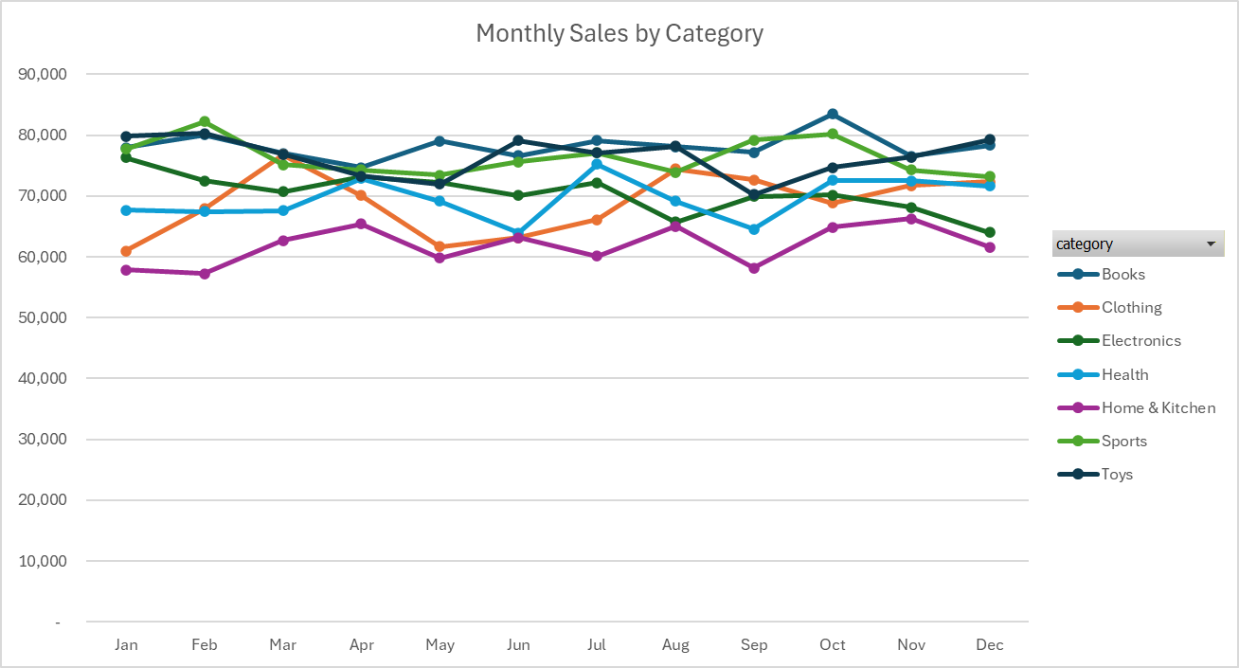
Monthly Sales by Category

Slide 11
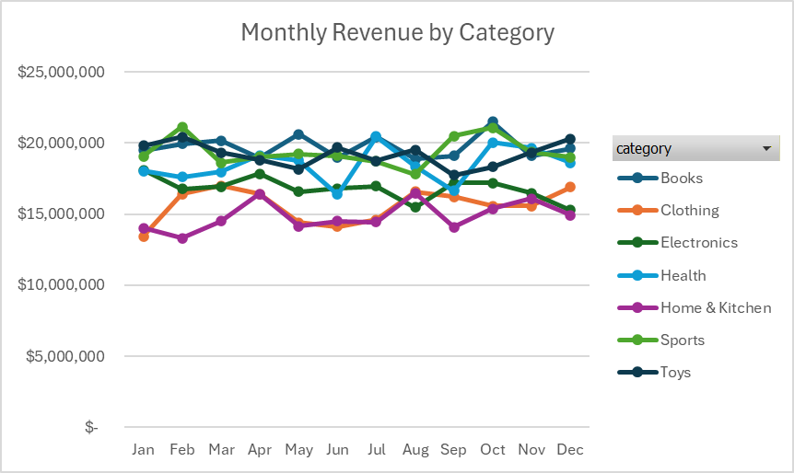
Monthly Revenue by Category

Slide 12
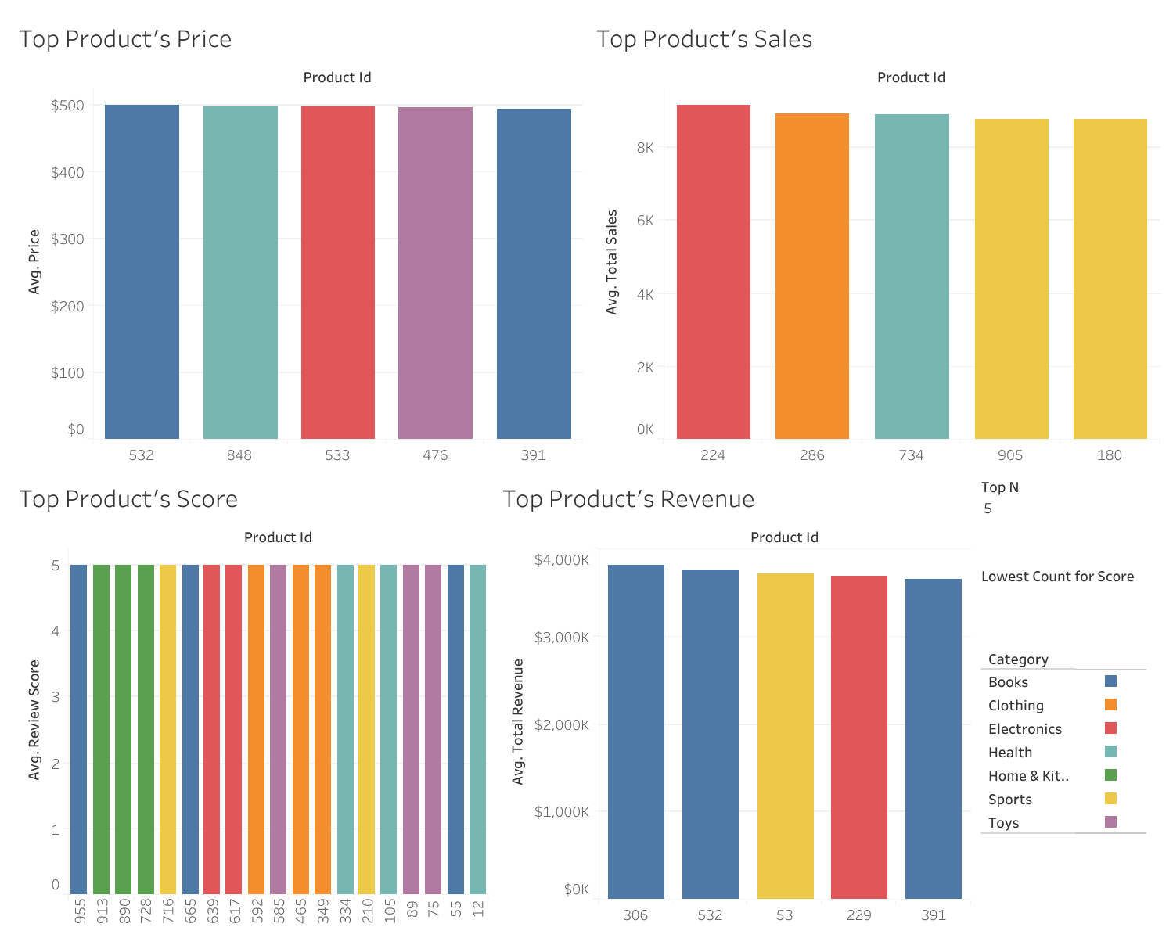

Slide 13
Special Findings in Regression Models
Clothing: Higher Review Score then Lower Sales
Clothing: Only Category that Higher Price then Lower Sales
Price has greater contribution to Revenue than Sales Volume

Slide 14
BUSINESS STRATEGY ADVISORY
ADJUSTMENT BASED ON SCIENCE

Slide 15
BUSINESS DIRECTION
Stop Relying on Books and Sports Products
Expand Markets in Clothes and Home & Kitchen
Top 2 in Revenue
Not Necessity
Revenue will be affected by Economies
Bottom 2 in Revenue
Necessities
Stabilize Future Revenue

Slide 16
SEASONAL ADJUSTMENT SUGGESTION
Following the monthly variation of each category, adopt different Discounts and Advertising campaigns
Offer Discount during low demand; Advertise during high demand
Month | Discount Sales Campaign | Advertisement
January | Clothing | Electronics
February | Home & Kitchen | Sports
March | Electronics | Clothing
April | Toys | Health
May | Sports | Books
June | Health | Toys
July | Home & Kitchen | Health
August | Sports | Toys
September | Toys | Sports
October | Clothing | Books
November | Electronics | Home & Kitchen
December | Sports | Toys

Slide 17
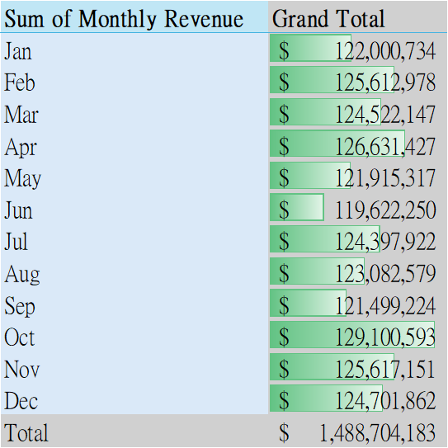
FINANCING SUGGESTION
Time Deposit or Buy Treasury Bills in High-Revenue months
Mature at Low-Revenue months
Earn Interest
Enhance Income Stability

Slide 18
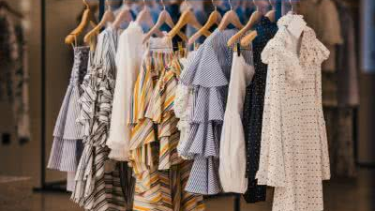
ADVERTISE HIGHLY RATED CLOTHES AS THEY DESERVE MORE BUYERS

Slide 19

PROVIDE MORE EXPENSIVE PRODUCTS TO INCREASE PROFIT MARGIN

Slide 20

FINAL TIPS & TAKEAWAYS

Slide 21
FINAL TIPS & TAKEAWAYS
Expand Business in Clothes, Home & Kitchen
Stabilize Revenue
Advertising and Sales vary with data
Response to Market
Financing at High-Months
Earn the Interest in Low-Times
Advertise High-Rated Clothes
Sell more Expensive Products

Slide 22

Q&A SESSION
ASK US QUESTIONS

Slide 23

THANK YOU

